Slide 1
Day 6

Slide 2
Data Source File
https://drive.google.com/drive/folders/1xcmHEYOB0clh54Y4-3EqEd0Fz8X8KYDk

Slide 3
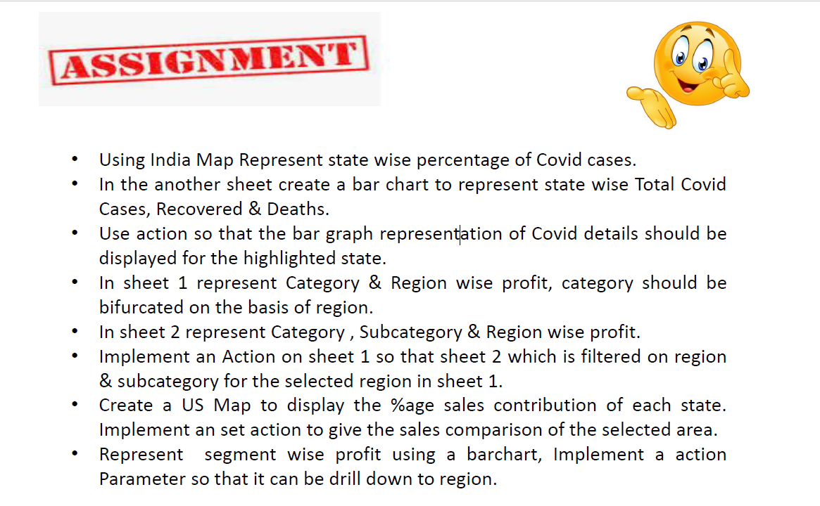
Questions

Slide 4
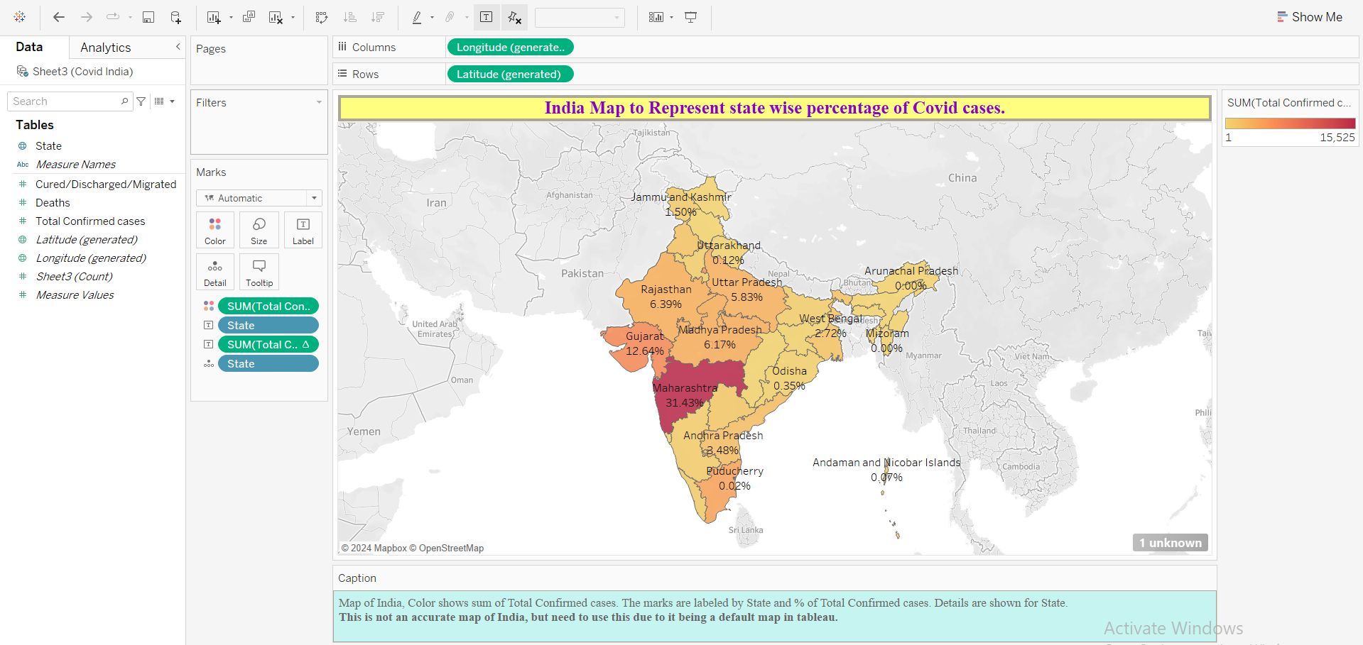
India Map to Represent state wise percentage of Covid cases.

Slide 5
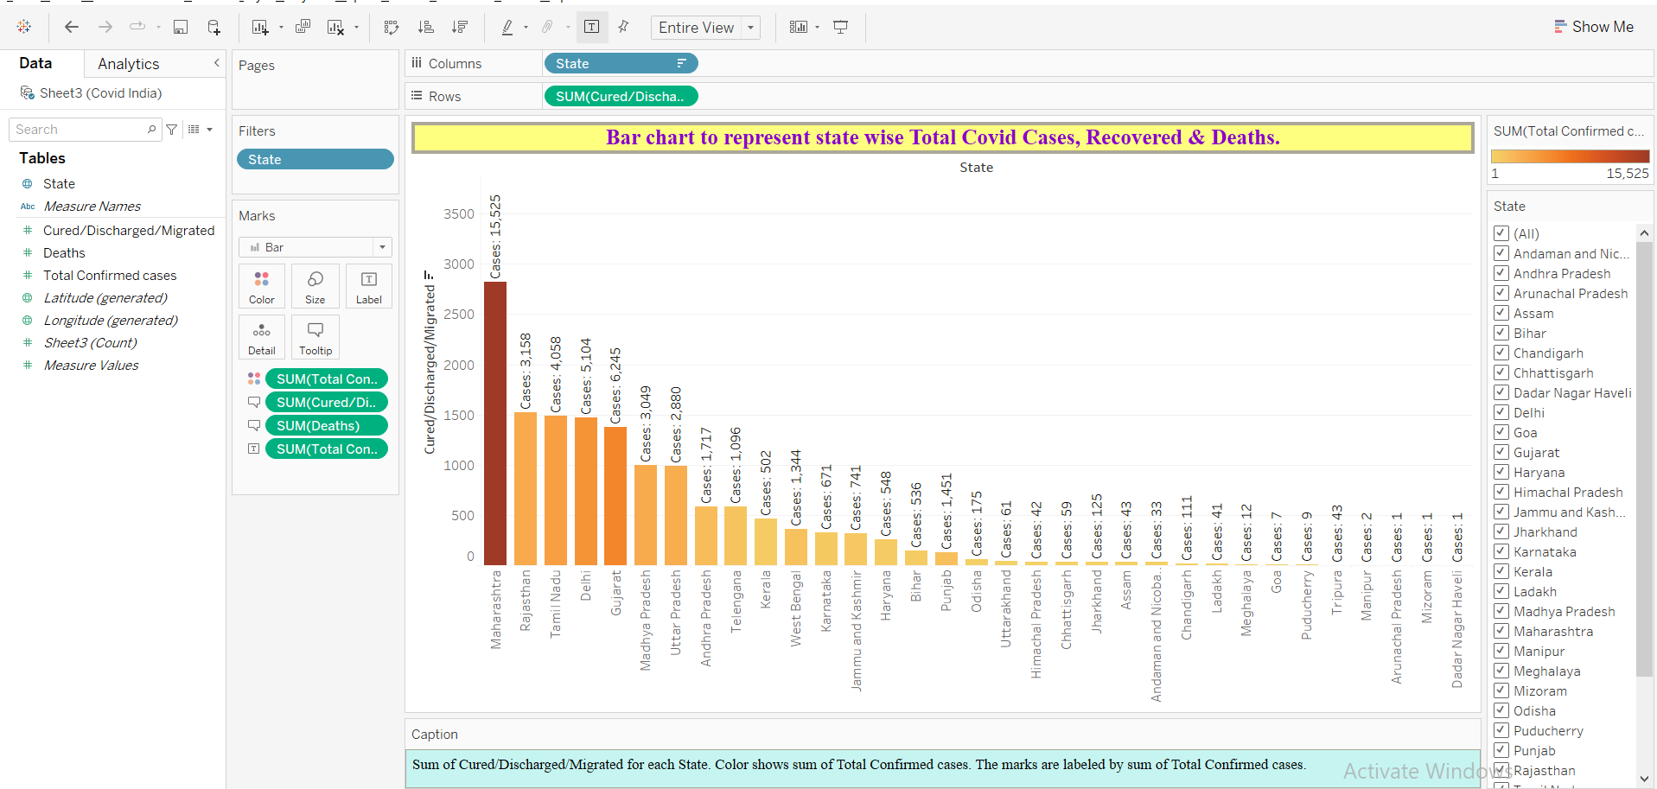
Bar chart to represent state wise Total Covid Cases, Recovered & Deaths.

Slide 6
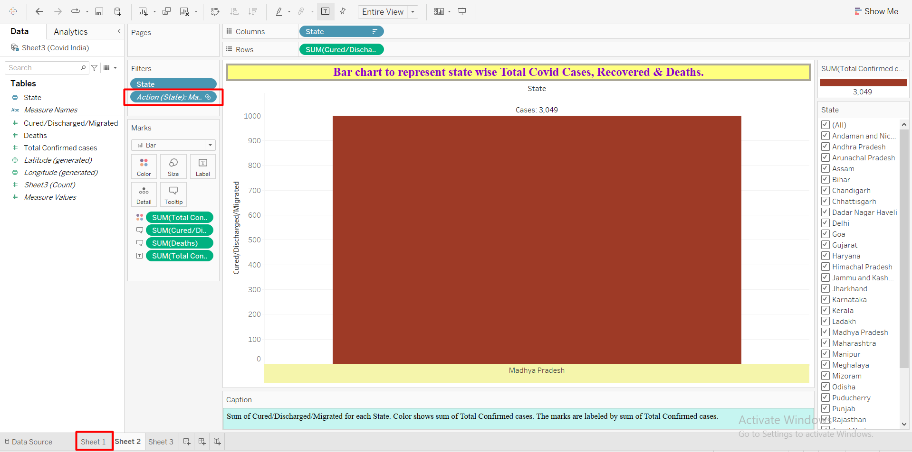
Action so that the bar graph represent action of Covid details should be displayed for the highlighted state.

Slide 7
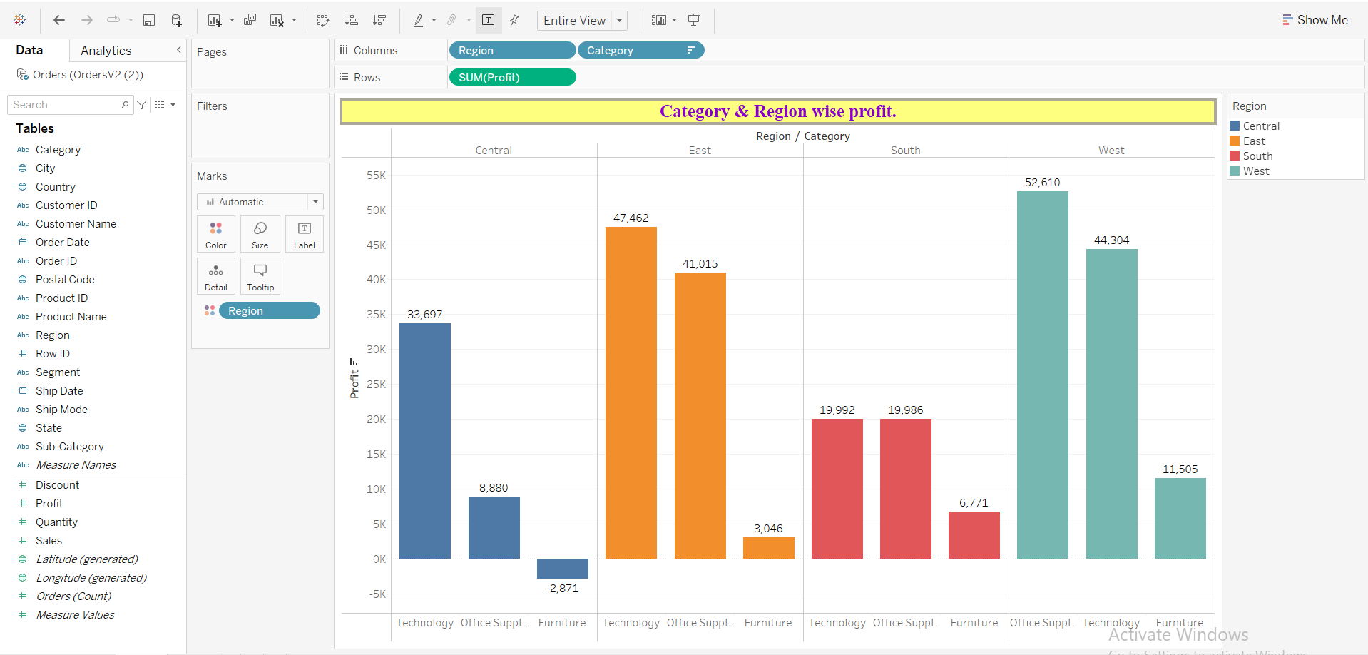
Category & Region wise profit.

Slide 8
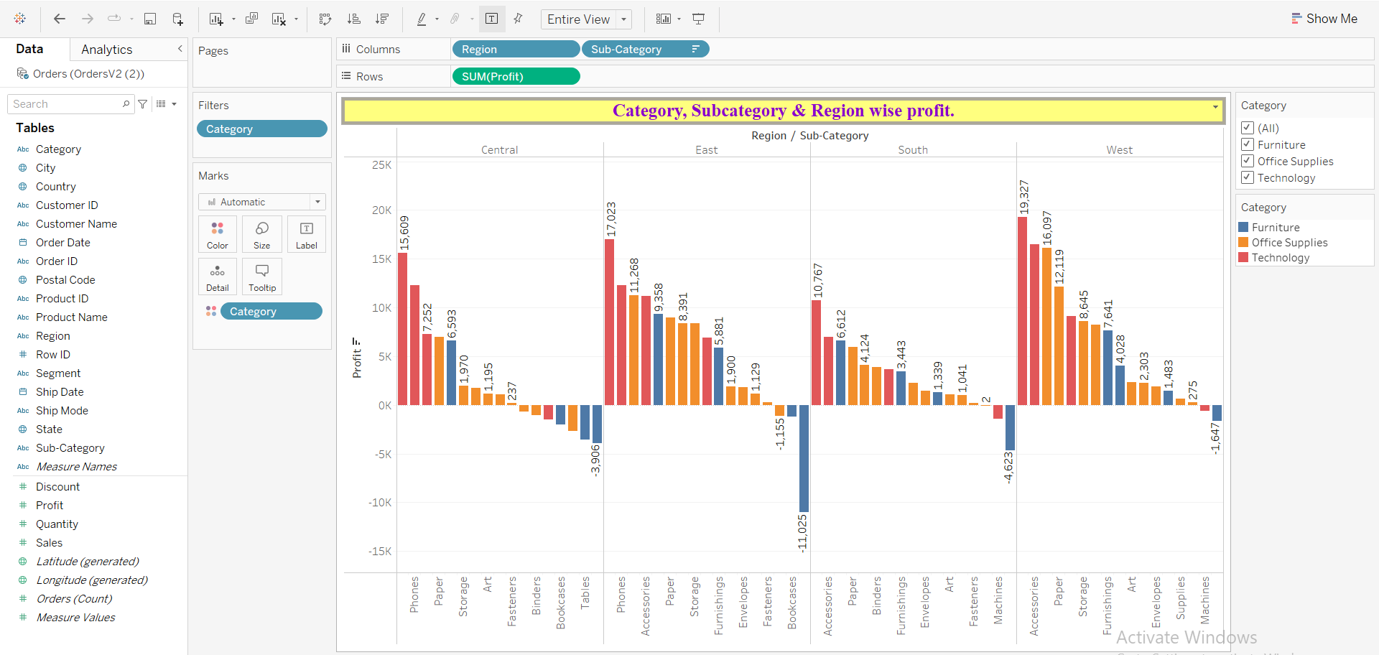
Category, Subcategory & Region wise profit.

Slide 9
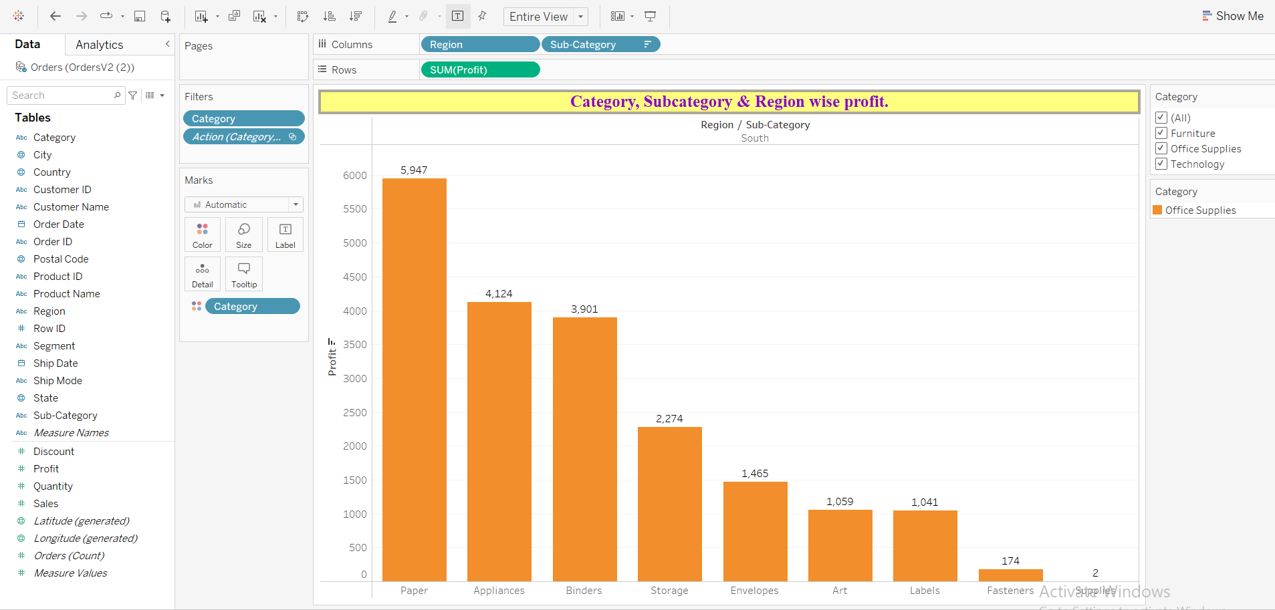
Action on sheet1 so that sheet2 which is filtered on region & subcategory for the selected region in sheet1.

Slide 10
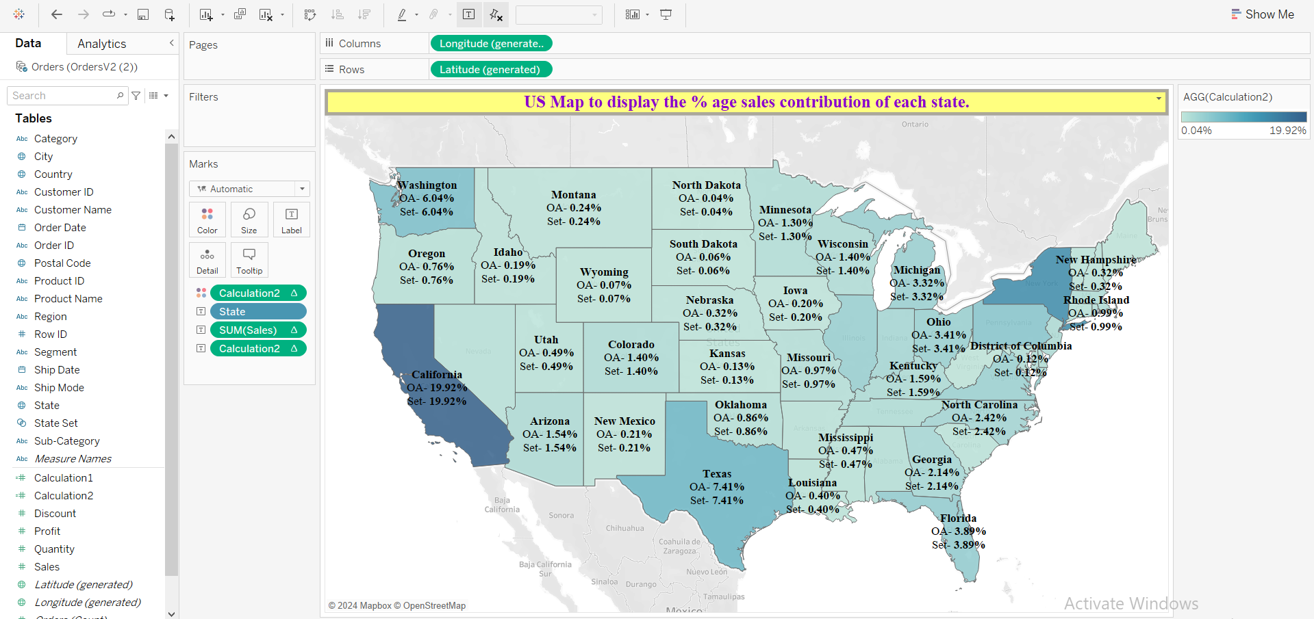
US Map to display the % age sales contribution of each state.

Slide 11
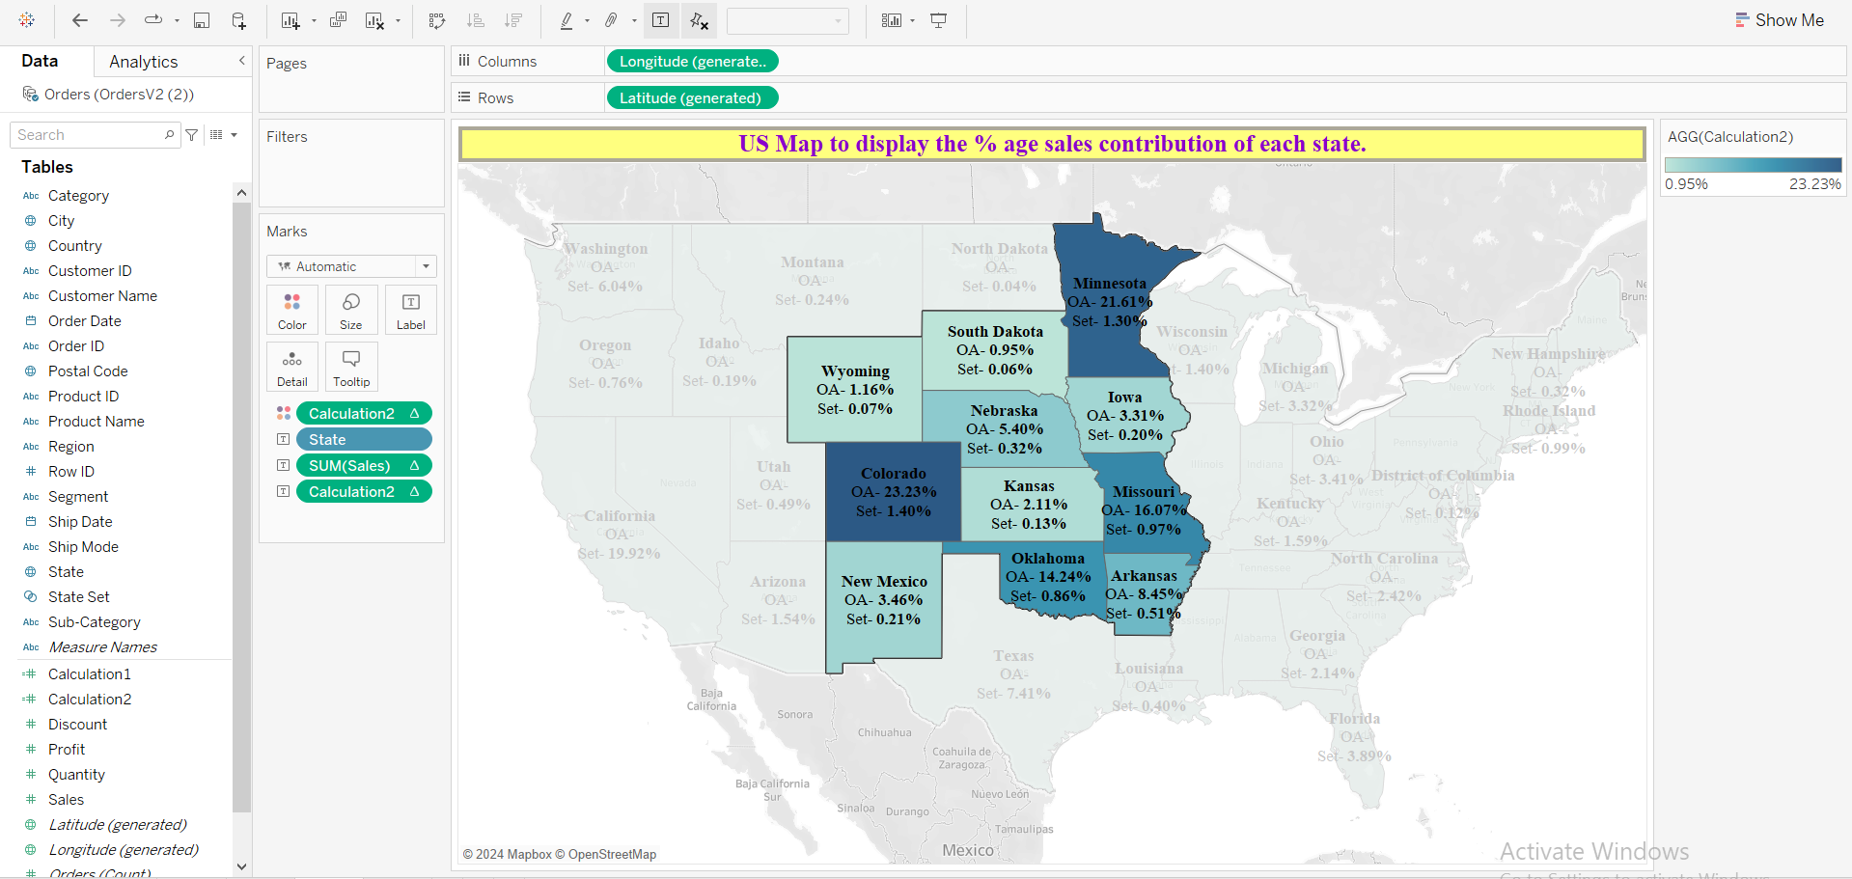
Set action to give the sales comparison of the selected area.

Slide 12
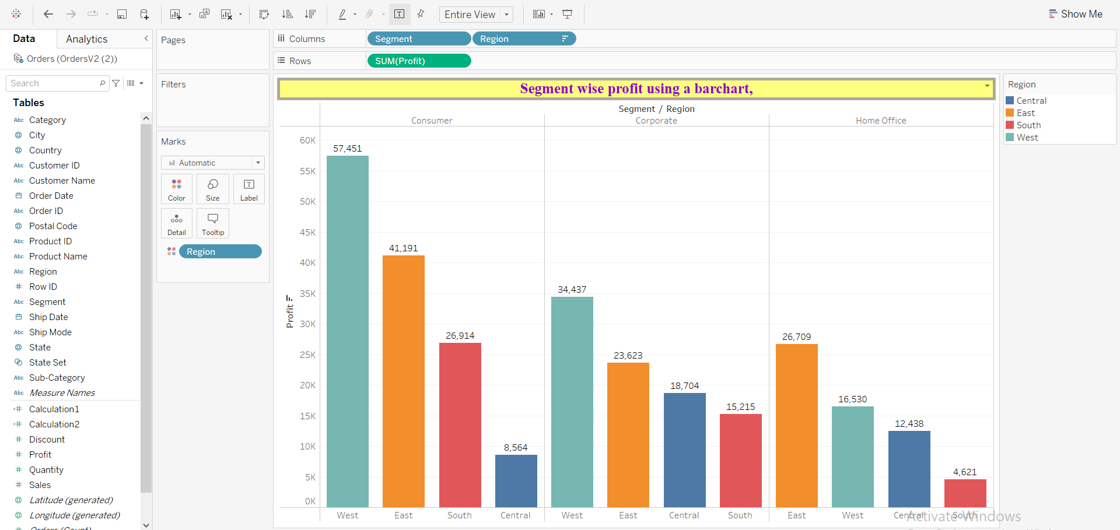
Segment wise profit using a bar chart.

Slide 13
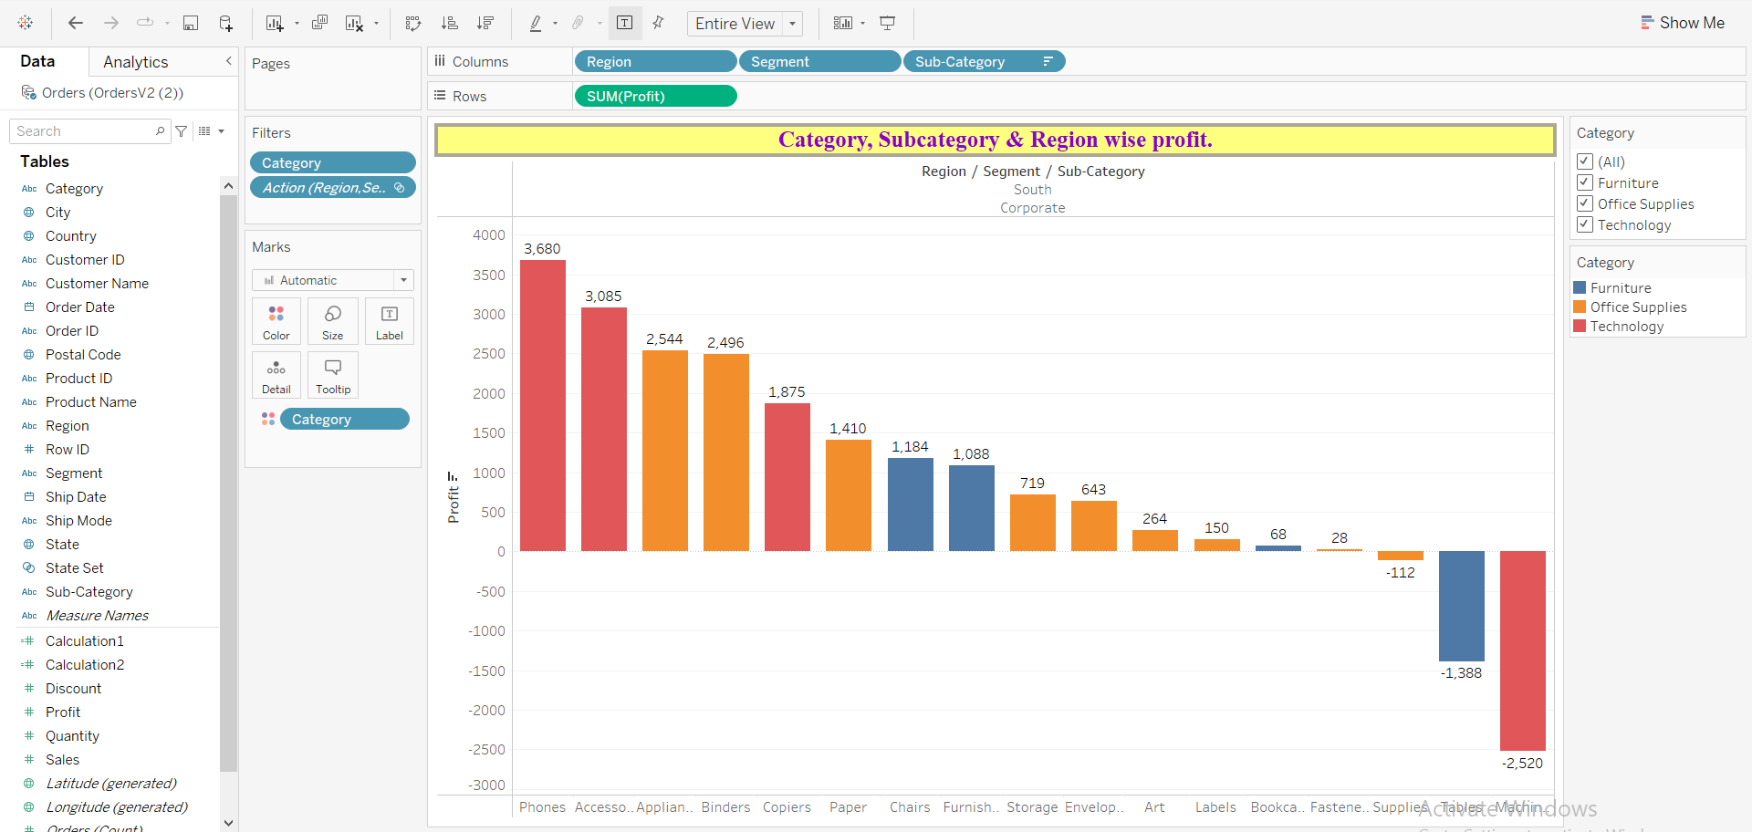
Segment wise profit using a bar chart.

